Slide 1
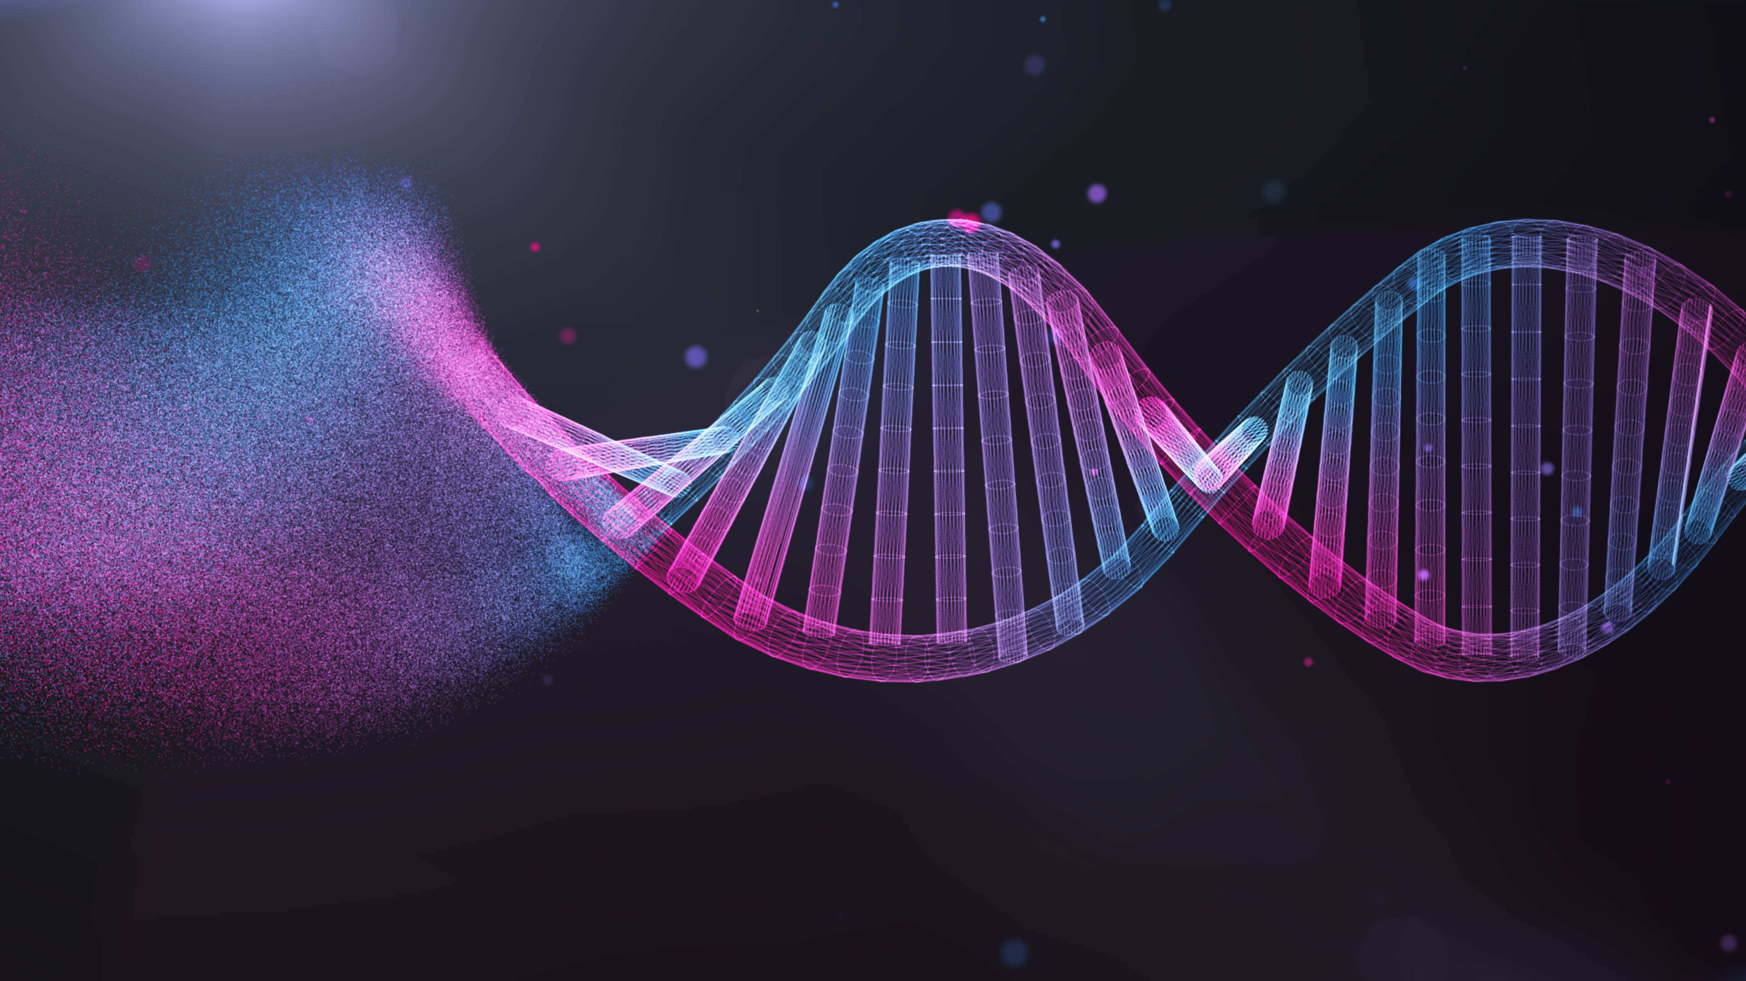
Transcriptome Analysis
Gilberto Gonzalez

Slide 2
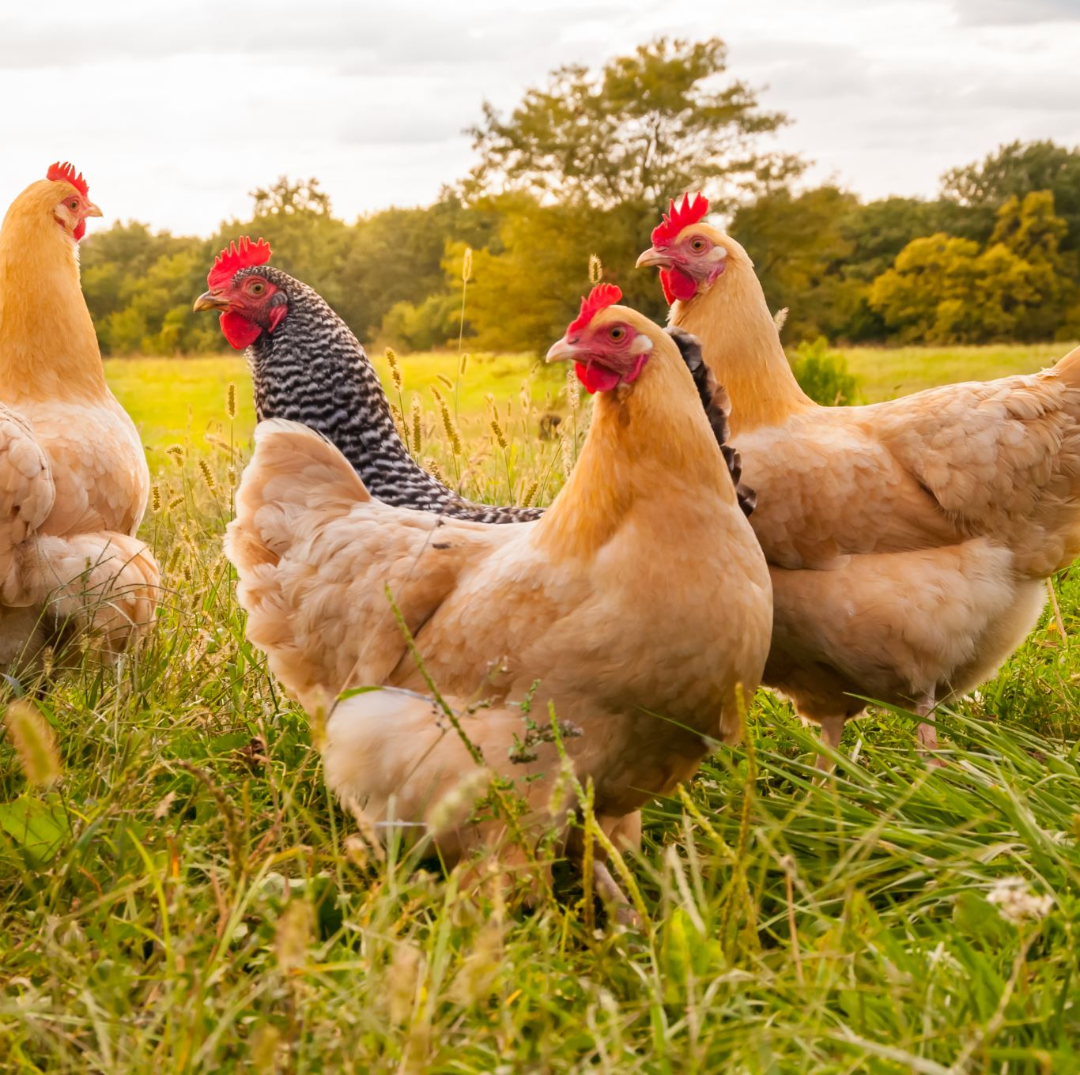
Introduction
To investigate the gene expression of broiler jejunum and ileum tissues at different time stages under probiotic treatment.
Transcriptome of a Chicken
21 days after use of probiotics (two replicates)
35 days after use of probiotics (two replicates)

Slide 3
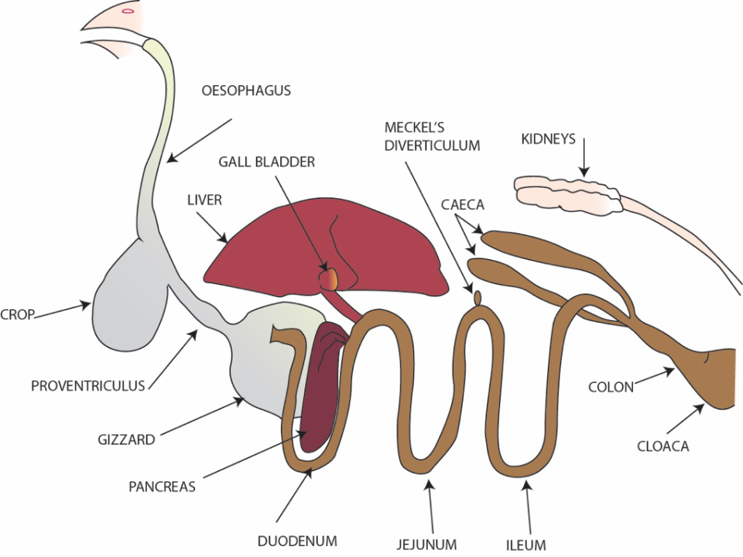
Illium & Jejunum Tissues

Slide 4

Methods/Programs used
Terminal
- Generated ballgown files
R-Studio
- Used files generated through terminal
- Produced multiple visualizations to help interpret/analyze the data
- Tables and Graphs

Slide 5
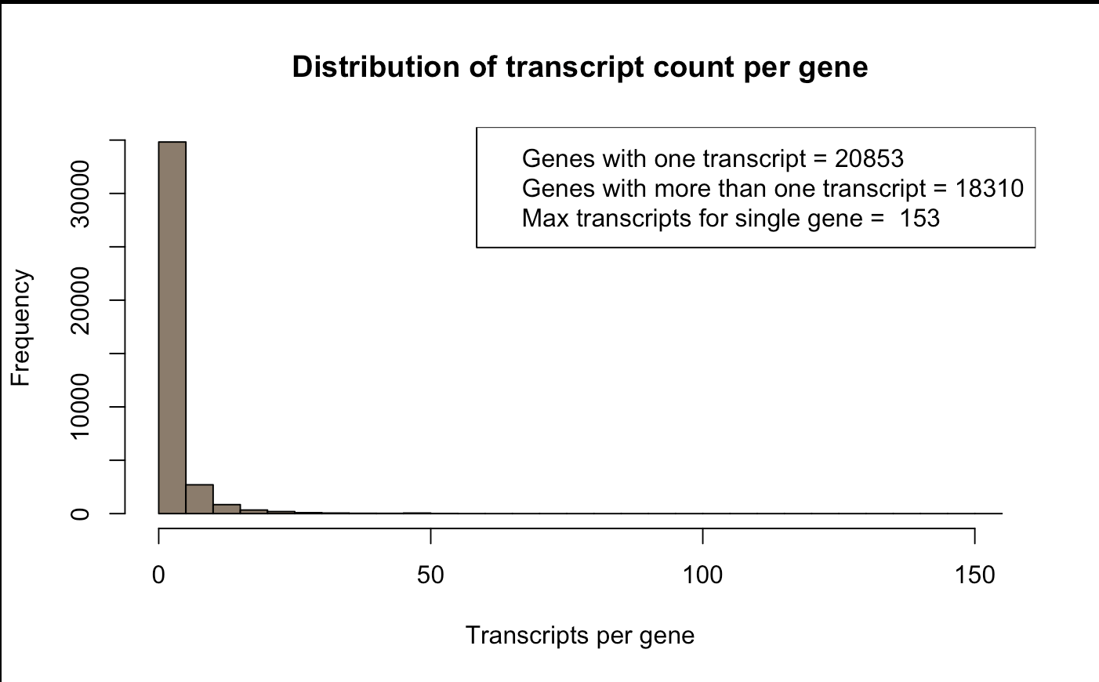
Most genes have few transcripts but also high frequency

Slide 6
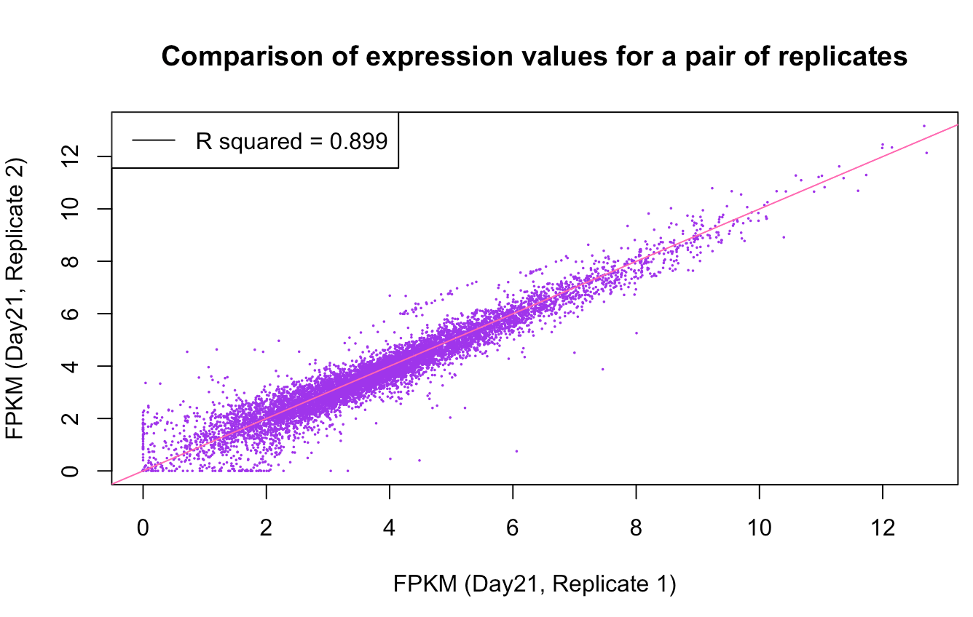
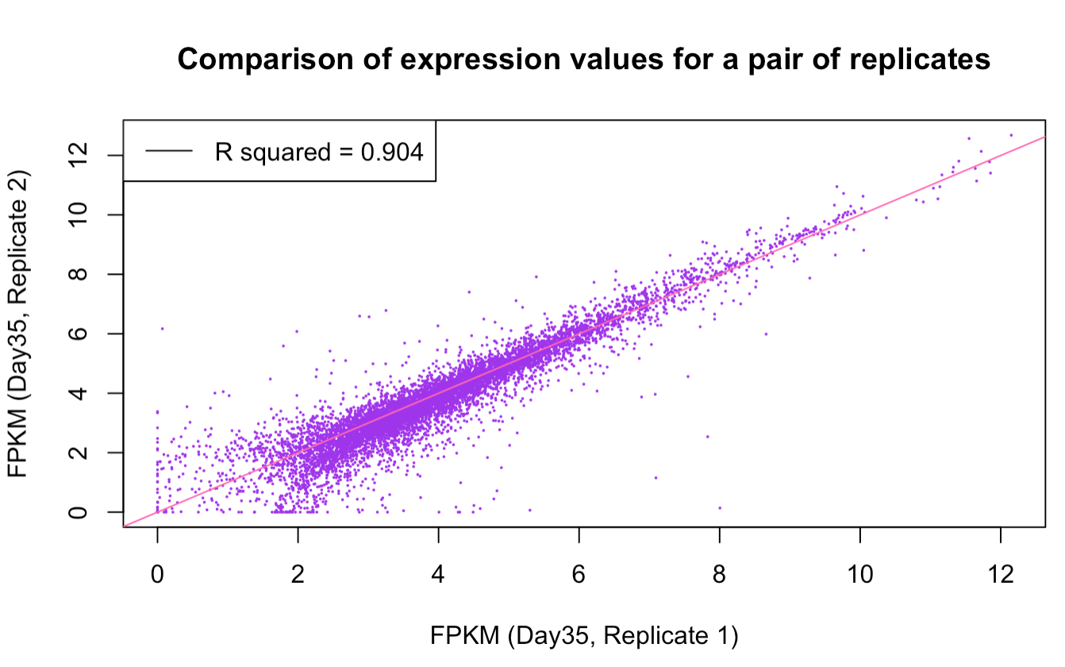
Day 21 after use of probiotics (Rep 1 vs 2)
Day 35 after use of probiotics (Rep 1 vs 2)
There is correlation between the Replicates 1 & 2 of Day 21
There is a high correlation between the Replicates 1 & 2 of Day 35

Slide 7
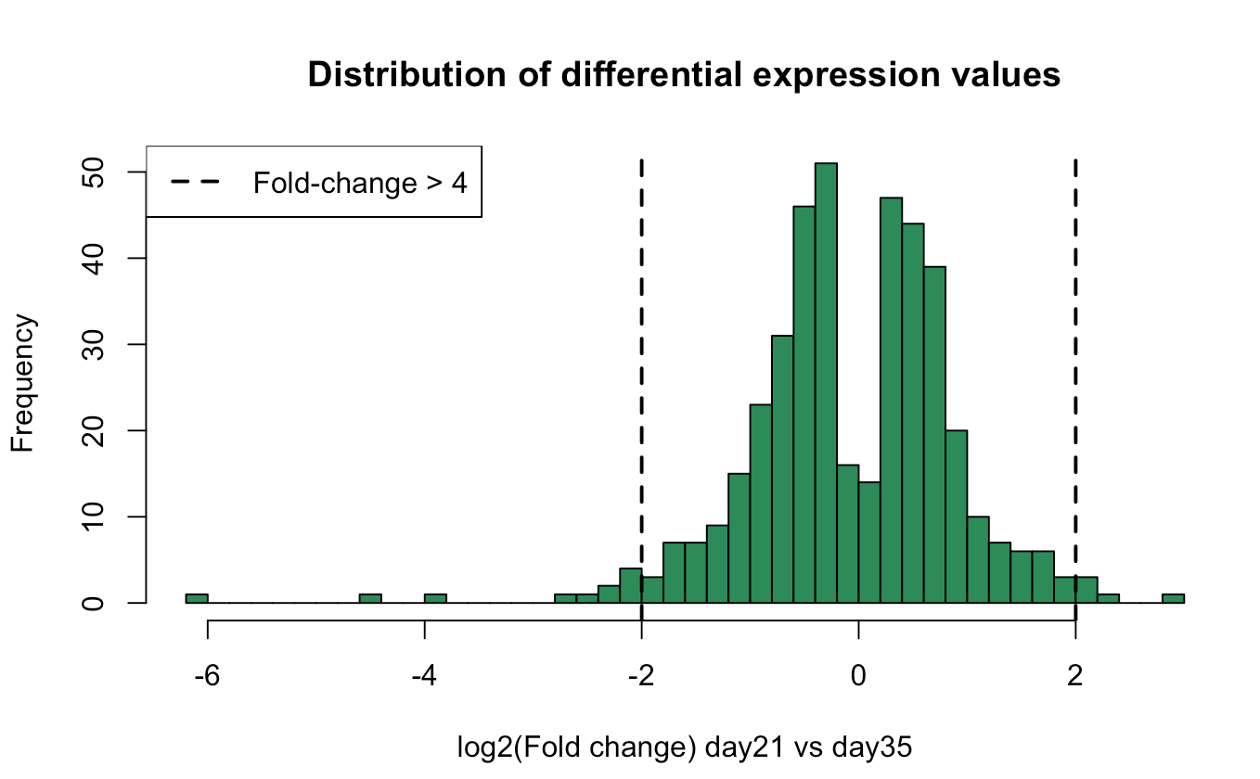
Day21 vs. Day35
Gene expression
0 = genes expression is the same on both day 21 & 35
Right of dashed line
Gene expression is >4 increase on day 21
Left of dashed line
gene expression is >4 decreased on day 21
Most gene expression is close to 0 meaning the gene expression is relatively the same on day 21 & day35

Slide 8
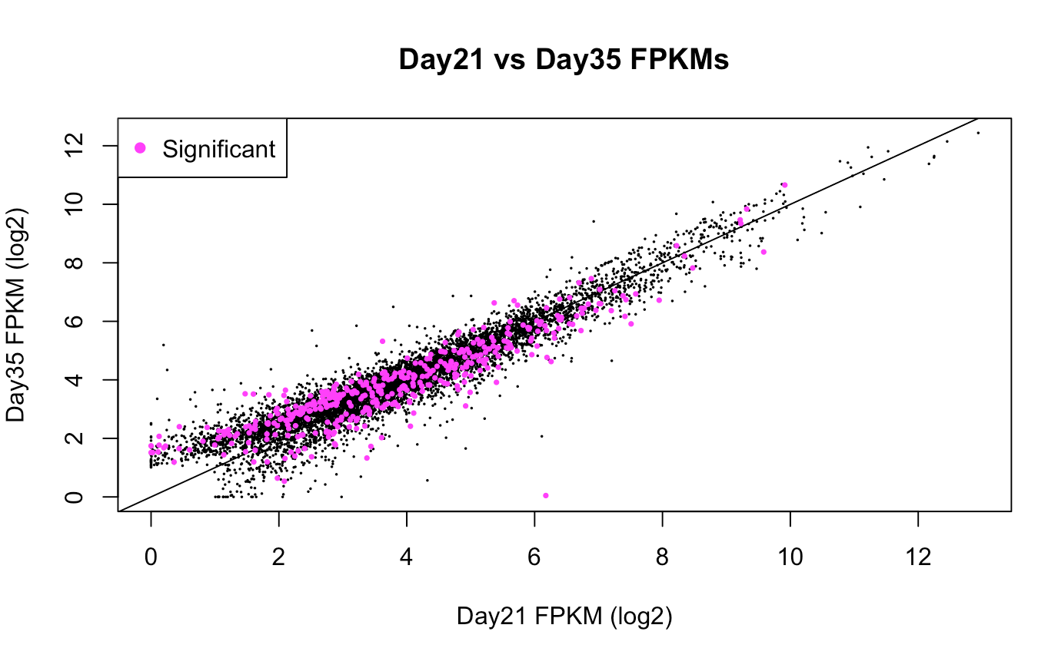
Day 21 vs. 35 gene expression
Plot total gene expression highlighting differentially expressed genes
Similar significant genes are being expressed both days

Slide 9
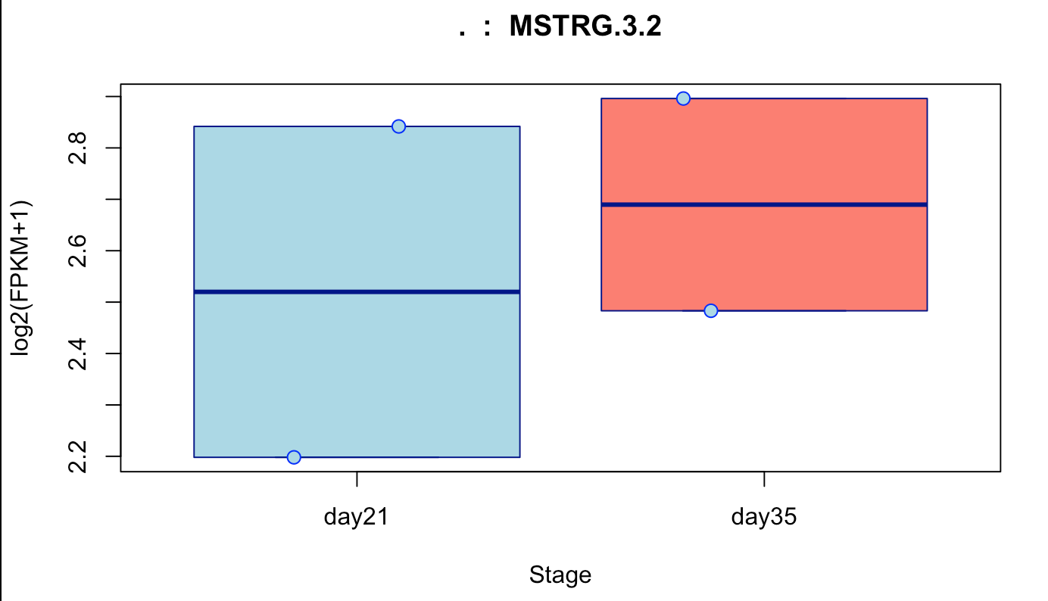
Expression of the MSTRG.3.2 gene
This gene is expressed at a higher rate at 35 days after use of probiotics
Expression of this gene in day 21 is very broad and it seems to narrow down by day 35

Slide 10
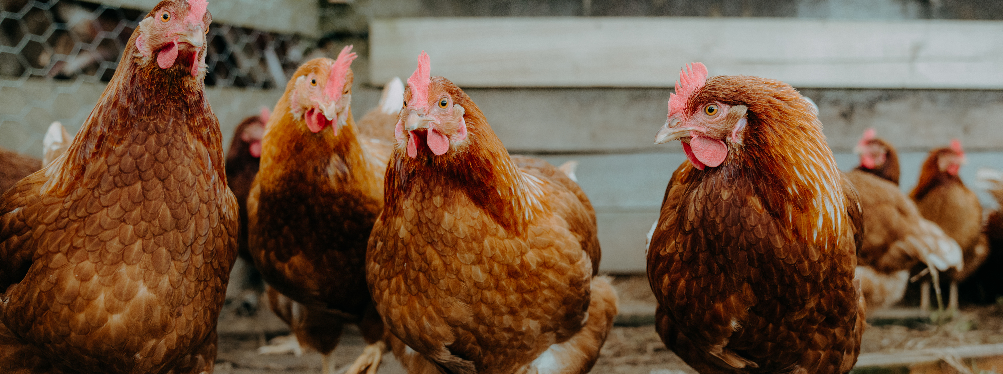
Conclusion
Gene expression in the jejunum and ileum tissue at different times after the use of probiotics did not change significantly

